Slide 1
LEARN MESH
Where Learners Link and Ideas Thrive.

Slide 2
Team Members
Tulasi Mallampati (G43626084)

Slide 3

About Project
A real-time web application that intelligently forms and manages study groups based on user’s skill levels, availability, and preferred learning styles.

Slide 4
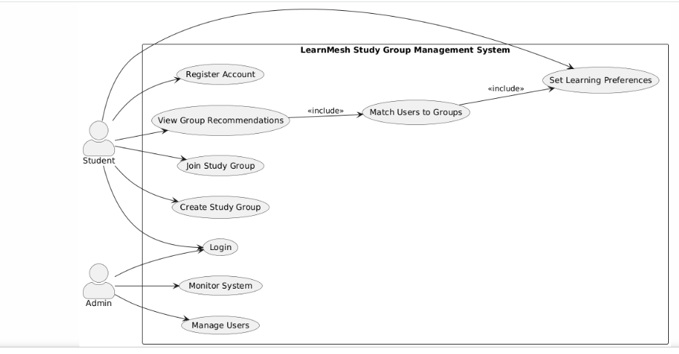
Use Case

Slide 5
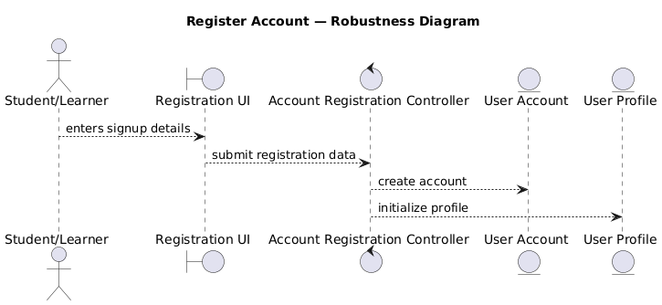
RegisterAccount

Slide 6
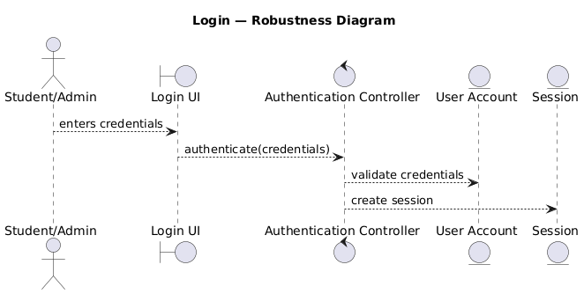
Login

Slide 7
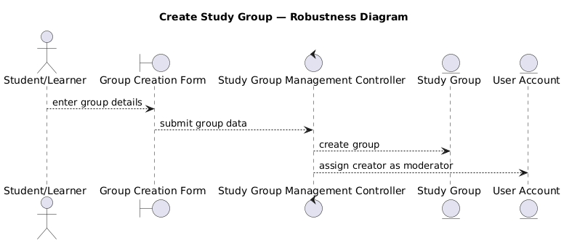
CreateStudyGroup

Slide 8
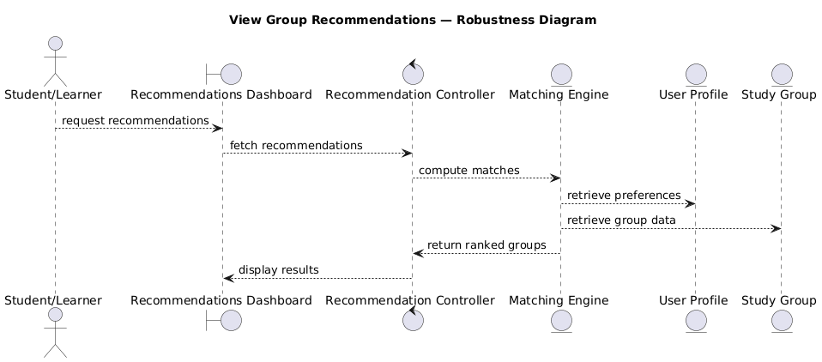
ViewGroupRecommendations

Slide 9
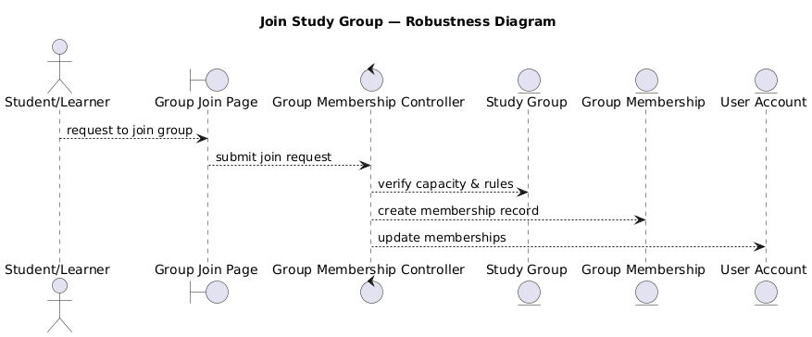
JoinStudyGroup

Slide 10
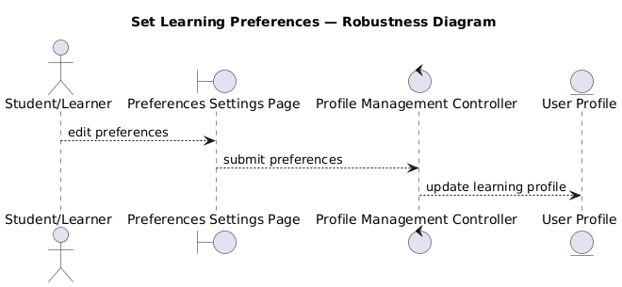
SetLearningPreferences

Slide 11
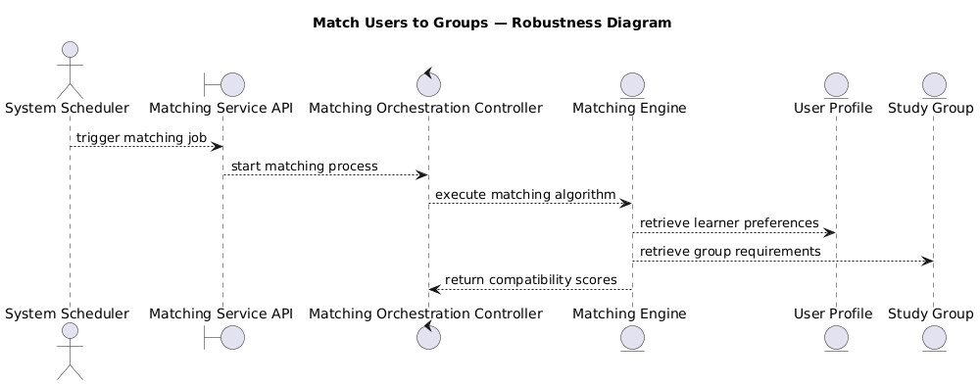
MatchUserstoGroups

Slide 12
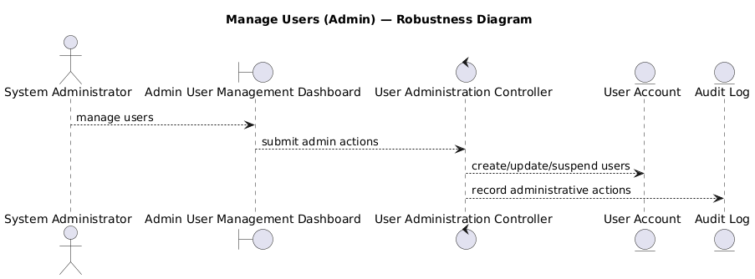
ManageUsers

Slide 13
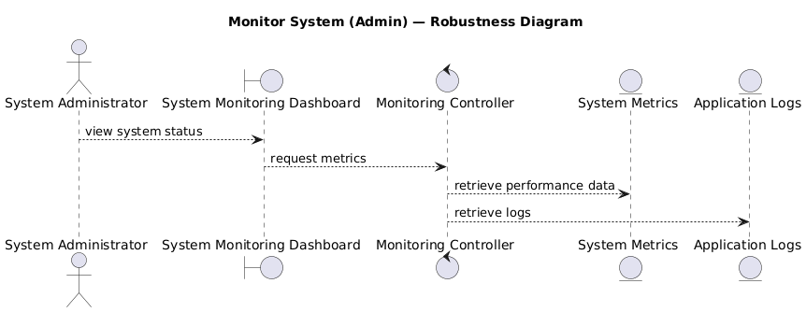
MonitorSystem

Slide 14
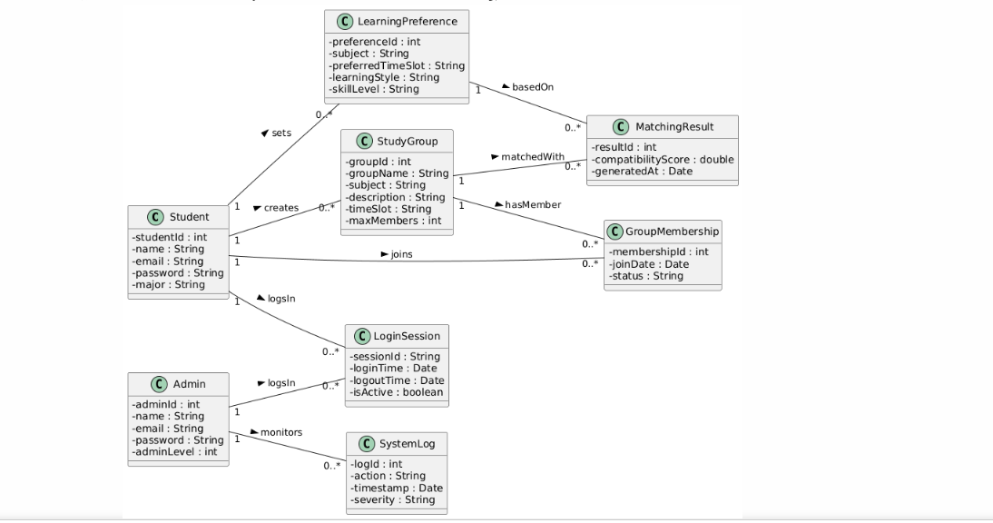
Domain Model Diagram

Slide 15
Thank You

